Slide 1
Working with the Web Part Property Pane
Leveraging the SPFx PnP Reusable Property Pane Controls

Slide 2

Introducing the Property Pane
Overview Reusable PnP Controls
Leveraging PnP Controls

Slide 3
Overview
Property pane controls included in SharePoint Framework API are basic input controls
Textbox, drop downs, sliders, toggles, links, lables, etc…
Don’t contain logic or details about current SharePoint site
Simple controls developers can use in web parts
Developers can add logic to initialize them (populate dropdown list with the lists from current site)
Developers can create custom property pane fields with these controls and additional business logic to create “smart controls”

Slide 4
Property Pane Controls for SPFx
Open source community library
Managed by the SharePoint Patterns & Practices(PnP) team
Includes reusable controls with logic tied to existing SharePoint site
https://sharepoint.github.io/sp-dev-fx-property-controls

Slide 5


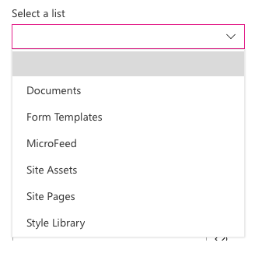
Popular Controls from the PnP Library
PropertyFieldColorPicker
Generates a color picker
PropertyFieldDateTimePicker
Create a datetime picker
PropertyFieldListPicker
Displays dropdown of lists from current SharePoint site
Supports single or multi-select
PropertyFieldPeoplePicker
Lists users & groups from the current SharePoint site
… and many more!

Slide 6
Adding to your project
// install as NPM package
npm install @pnp/spfx-property-controls --save --save-exact
// import reference in web part
import { PropertyFieldListPicker, PropertyFieldListPickerOrderBy } from '@pnp/spfx-property-controls/lib/PropertyFieldListPicker’;
// add to property pane configuration
PropertyFieldListPicker('lists', {
label: 'Select a list',
selectedList: this.properties.lists,
includeHidden: false,
orderBy: PropertyFieldListPickerOrderBy.Title,
disabled: false,
onPropertyChange: this.onPropertyPaneFieldChanged.bind(this),
properties: this.properties,
context: this.context,
onGetErrorMessage: null,
deferredValidationTime: 0,
key: 'listPickerFieldId'
})

Slide 7
Demo Leveraging the SPFx PnP Reusable Property Pane Controls

Slide 8

Summary
Overview Reusable PnP Controls
Leveraging PnP Controls

Slide 9
Reading further
Overview of the SharePoint Framework
https://docs.microsoft.com/sharepoint/dev/spfx/sharepoint-framework-overview
Make your SharePoint Client-Side Web Part Configurable
https://docs.microsoft.com/sharepoint/dev/spfx/web-parts/basics/integrate-with-property-pane
Reusable Property Panel Controls for SharePoint Framework Solutions
https://sharepoint.github.io/sp-dev-fx-property-controls/

Slide 10
Thank you.

